Slide 1

Exploratory Data Analysis
<G2M Case Study>
<03/19/23>

Slide 2

Agenda
Executive Summary
Problem Statement
Approach
EDA
EDA Summary
Recommendations

Slide 3




Data Exploration
Cab_data.csv
Customer_ID.csv
Transaction_ID.csv
City.csv
22 features ( including 4 derived features)
Timeframe of the data: 2016-01-01 to 2018-12-31
Total Data Points: 359,392
Assumptions:
Outliers are present in Price_Charged and Cost_of_Trip features, but due to the unavailability of trip duration details, we are not treating these as outliers.
Profit of rides is calculated, keeping other factors constant and only Price_Charged and Cost_of_Trip features used to calculate profit.
Users feature of the city dataset is treated as the number of cab users in the city. We have assumed that this can be other cab users as well (including Yellow and Pink cabs).
Cab_df.csv

Slide 4
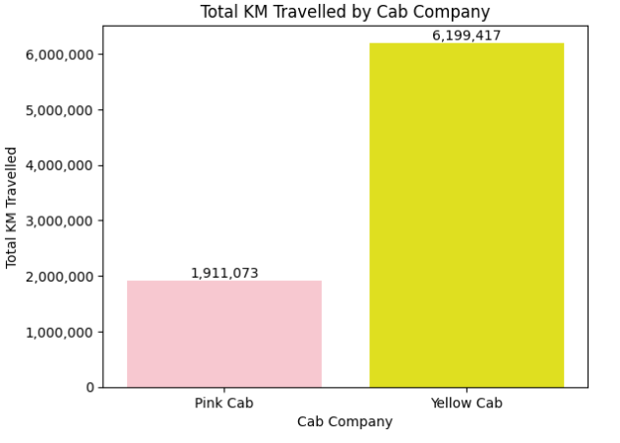
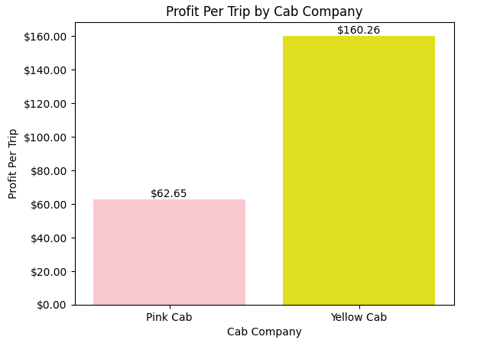
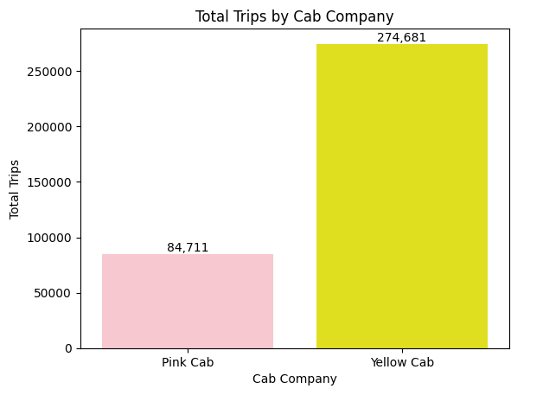
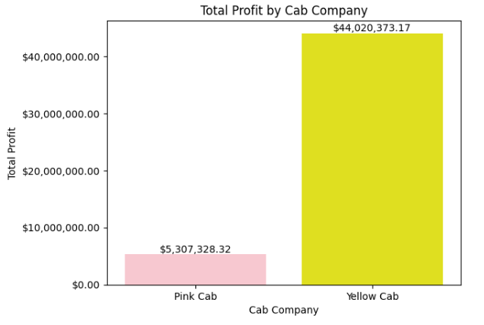

Overview of Cab Company's

Slide 5
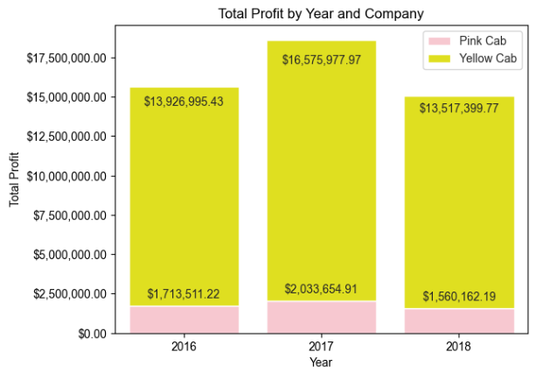
Profit By Year
Both companies have been generating a substantial profit and exhibit impressive performance metrics. However, Yellow Cab clearly stands out as the dominant player, outperforming Pink Cab in every metric throughout the overall analysis. Both companies experienced a peak in profit in 2017, but their profit levels in 2018 were lower than in 2016. This raises the question of whether both companies are experiencing a gradual decline in profitability. Further analysis would be needed to determine the underlying causes and assess the long-term trends.

Slide 6
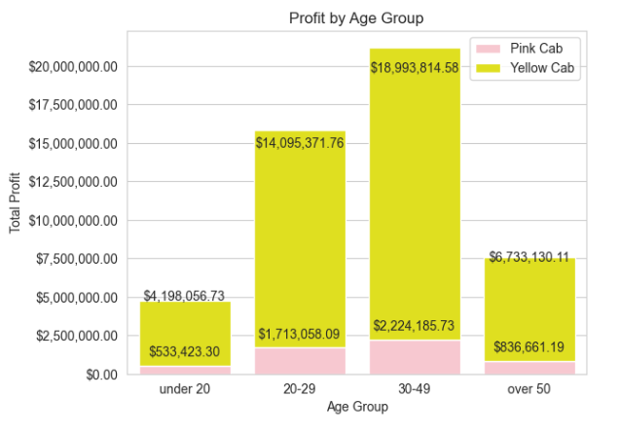
Analysis of Age
The 30-39 age range is the highest performing segment for Yellow Cab by a significant margin. For Pink Cab, the 20-29 and 30-39 age groups are quite close in terms of performance. Both companies have their lowest performance in the under-20 age group, which is to be expected considering that younger individuals might have less disposable income or less need for cab services. These insights can help both companies tailor their marketing and operational strategies to target their key customer segments more effectively.

Slide 7
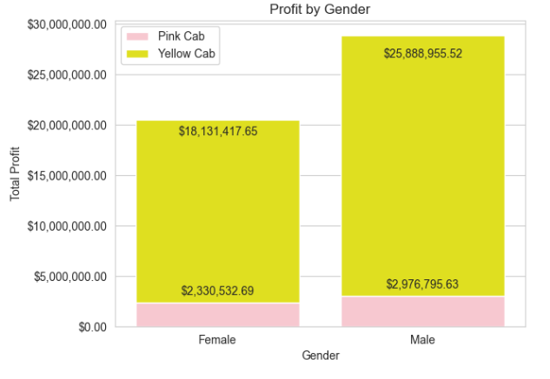
Analysis of Gender
Both companies observe that male customers generate the most profit, which is a valuable insight for tailoring marketing campaigns. By understanding that males contribute more significantly to their revenue, both Pink Cab and Yellow Cab can develop targeted advertising and promotional strategies to further engage this demographic. Additionally, they could explore the preferences and needs of their male customers to better cater to their demands, ultimately maximizing profitability and customer satisfaction.

Slide 8
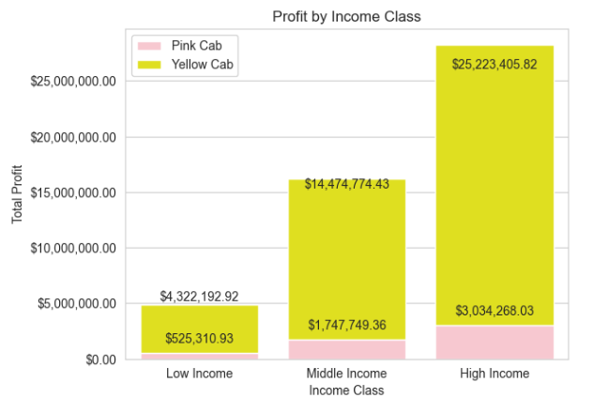
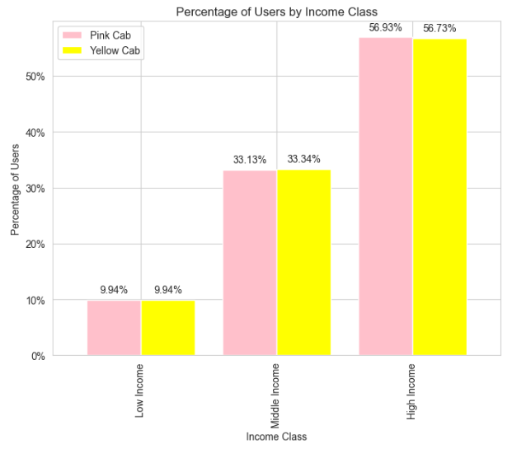
Analysis of Income
The observation that customers with high income contribute the most to the profit is an important insight for both Pink Cab and Yellow Cab. As these high-income individuals have more disposable income, they are more likely to use taxi services more frequently or for longer distances. This information can help both companies focus on catering to the preferences and expectations of their high-income customers, offering premium services, and developing targeted marketing campaigns that appeal to this demographic. By doing so, they can further capitalise on this segment's potential to drive even greater profitability.

Slide 9
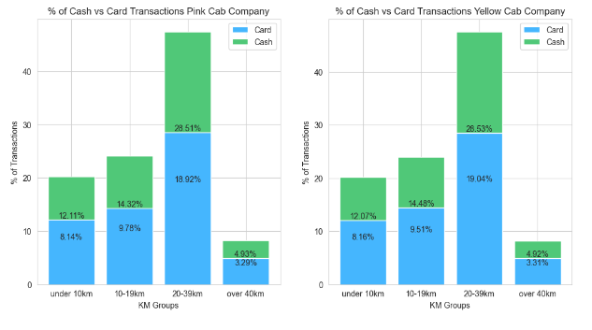
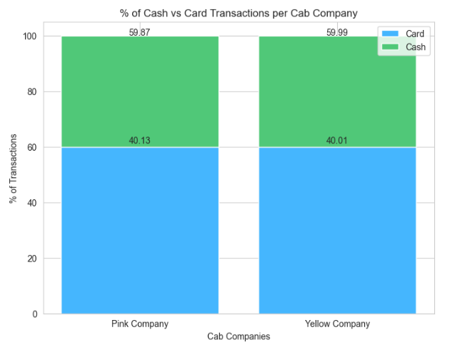
Analysis of Payments
Both companies exhibit very similar trends in their payment data, with card transactions accounting for the largest percentage of payments. However, the difference is not overwhelming. As we progress further into the digital age, we can expect card usage to rise even more, eventually becoming the predominant payment method
The majority of taxi rides are within the 20-39 km distance group, highlighting that shorter trips are the most common for both Pink Cab and Yellow Cab companies

Slide 10
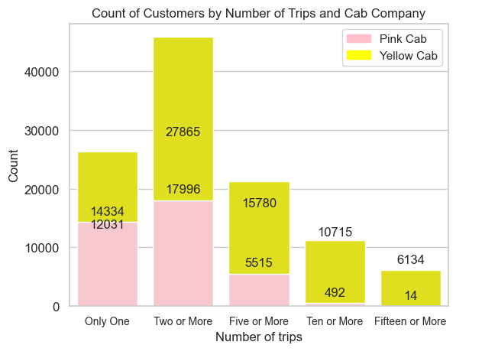
Analysis of Trips Per Customer
It's encouraging to see that the majority of the data shows customers taking 2 or more trips. This indicates that both Pink Cab and Yellow Cab have a good level of customer retention, as people are returning to use their services multiple times. Although having a single trip as the second-highest category suggests there is room for improvement, the fact that most customers are taking multiple trips demonstrates that these cab companies are doing something right.

Slide 11
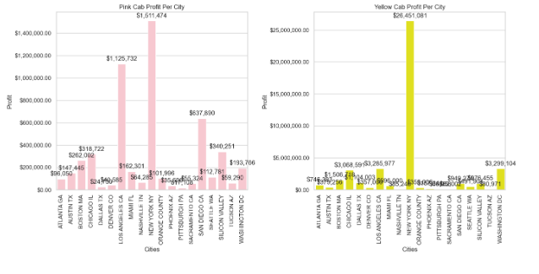
Profit Per City
It's not surprising that New York City generates the most profit for both Pink Cab and Yellow Cab, given its status as the largest and one of the busiest cities in the United States. The high population density and extensive transportation needs of its residents and visitors make it a prime market for taxi services.
Pink Cab has Los Angeles as its second most profitable city, while Yellow Cab has it very close to the top as well. This also makes sense, considering that Los Angeles is another major city with a large population and a well-established demand for transportation services.

Slide 12
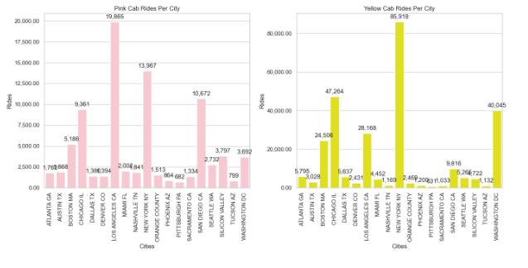
Cab Rides Per City
It is indeed surprising that Pink Cab has more trips in Los Angeles than in New York, despite New York being their most profitable city. This information could indicate that Pink Cab might be able to improve their profitability in Los Angeles by optimising their pricing strategy, operational efficiency, or marketing efforts.
Yellow Cab's Chicago presence is noteworthy as well, as it ranks second in terms of the number of trips, while it is the fourth most profitable city for the company. This suggests that there might be potential for Yellow Cab to increase profitability in Chicago by leveraging their already strong presence in the city.

Slide 13
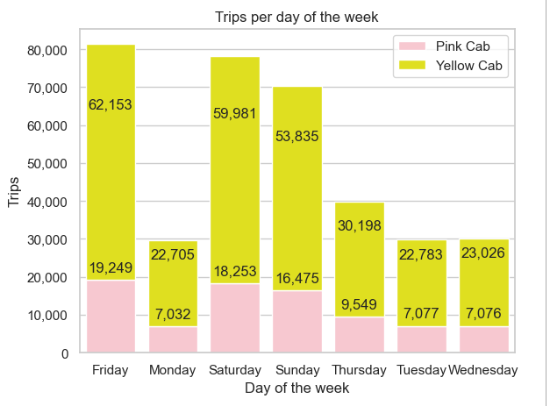
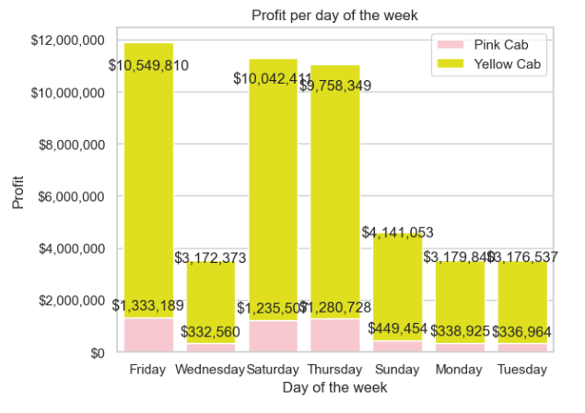
Analysis of days of the week
It appears that the number of trips and profits have a strong correlation in the data, indicating that as the number of trips increases, so does the profit. This relationship can be helpful for both Pink Cab and Yellow Cab when making operational and strategic decisions.
Since the two variables are closely linked, the companies can focus their efforts on increasing the number of trips, knowing that it will likely lead to higher profits.
On busy days like Friday and Saturday, the companies can allocate more cabs to meet the increased demand, ensuring that customers can access a cab whenever they need one. This could lead to higher customer satisfaction and potentially boost revenues during peak times.
On slower days like Wednesday and Monday, the companies might consider reducing the number of cabs on the road, thereby lowering operational costs without significantly impacting customer availability.

Slide 14
Summary
We have evaluated both cab companies, Yellow Cab and Pink Cab, on various aspects and found that Yellow Cab outperforms Pink Cab in several areas:
Customer Reach: Yellow Cab has a higher customer reach in 25 cities, while Pink Cab has a higher reach in only 4 cities. Yellow Cab also shows better performance in covering other cab users compared to Pink Cab.
Customer Retention: Analysing customer retention in two segments (at least 5 drives and at least 10 drives with the same cab company), we found that Yellow Cab performs significantly better than Pink Cab in both segments.
Age-wise Reach: Yellow Cab has customers in all age groups, and it is even popular among the 60+ age group, as much as it is in the 18-25 age group.
Average Profit per KM: Yellow Cab's average profit per KM is nearly three times higher than Pink Cab’s.
Income-wise Reach: Both cab companies are popular in the high and medium-income classes, but Yellow Cab performs better than Pink Cab in offering services to all three income groups (low, medium, and high).
Ride count and Profit Forecasting: Both companies face a decline in profit and ride numbers. Yellow Cab's forecasted profit loss is around 1.83%, while Pink Cab's loss is 3.1%. Pink Cab experiences a more significant loss even when its forecasted ride count loss is less than Yellow Cab’s.
Based on these findings, we recommend investing in Yellow Cab over Pink Cab.

Slide 15
Thank You

